Slide 1
Experiment 2 to 4
Experiment 2- Half Adder
Experiment 3- Full Adder Experiment 4- Half Subtractor

Slide 2
AND GATE: wave form
/AND
module andGate;
reg x; // Inputx
reg y; // Inputy
wire z; // Outputz
andComp uut (
.x(x),
.y(y),
.z(z)
);
initial begin // Initialize Inputs
x = 0;
y = 0;
#2 x = 1;
#2 y = 1;
#2 x = 0;
//#20 x = 1;
//#40;
end
initial begin
$dumpfile("andGate.vcd");
$dumpvars(0, andGate);
$display("INPUT\tOUTPUT");
$monitor("x=%d,y=%d,z=%d \n",x,y,z);
end
endmodule
module andComp(
input x,
input y,
output z
);
assign z = x&y;
endmodule
Dot (.) indicates that the port name following the dot belongs to the design. The signal name to which the design port has to be connected is given next within parentheses ( ) .
.x(a): signal “x” in the design should be connected to “a” in the module

Slide 3
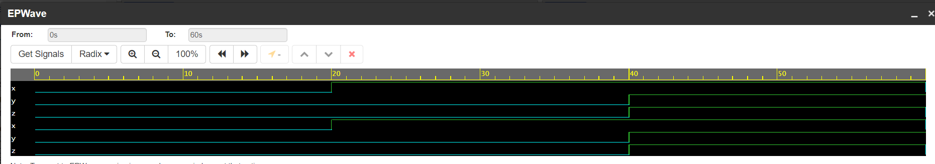
AND GATE: wave form
Online EDA Playground: https://www.edaplayground.com/home
From Tools & Simulator: select a Verilog simulator
Check: Open EPWave after run

Slide 4
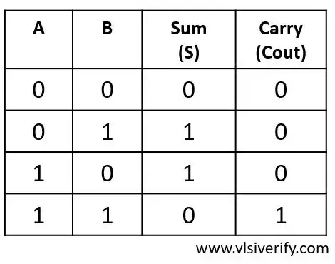
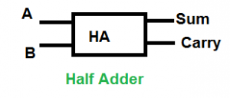
Experiment 2- Half Adder
To design and verify a half adder using S= (x+y)(x’+y’), C= xy
Half Adder: Half Adder is a basic combinational design that can add two single bits and results to a sum and carry bit as an output.

Slide 5
Experiment 2- Half Adder
To design and verify a half adder using S= (x+y)(x’+y’), C= xy
Output: S = A ^ B
Cout = A · B

Slide 6
Experiment 2- Half Adder
To design and verify a half adder using S= (x+y)(x’+y’), C= xy
Output: S = A ^ B
Cout = A · B
Half Adder Verilog Code:
//save as “halfadder.v”
module halfadder(a, b, sum, carry);
input a, b;
output sum,carry;
/* Using data flow level */
assign sum = a ^ b; //sum bit
assign carry = a & b; //carry bit
/* using gate level*/
/*
xor x1(sum, a, b);
and a1(carry, a, b);
*/
endmodule

Slide 7
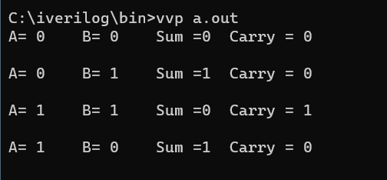
Experiment 2- Half Adder
To compile CMD Commdds:
iverilog halfadder.v halfadder_tb.v
vvp a.out
Testbench Code:
//save as “halfadder_tb.v”
module halfadder_tb;
reg a, b;
wire sum, carry;
halfadder add1(a, b, sum, carry);
initial
begin
$monitor("Time = %d: A= %b B= %b Sum =%b Carry = %b\n", $time, a, b, sum, carry);
a = 0; b = 0;
#1
b = 1;
#1
a = 1;
#1
b = 0;
end
endmodule

Slide 8
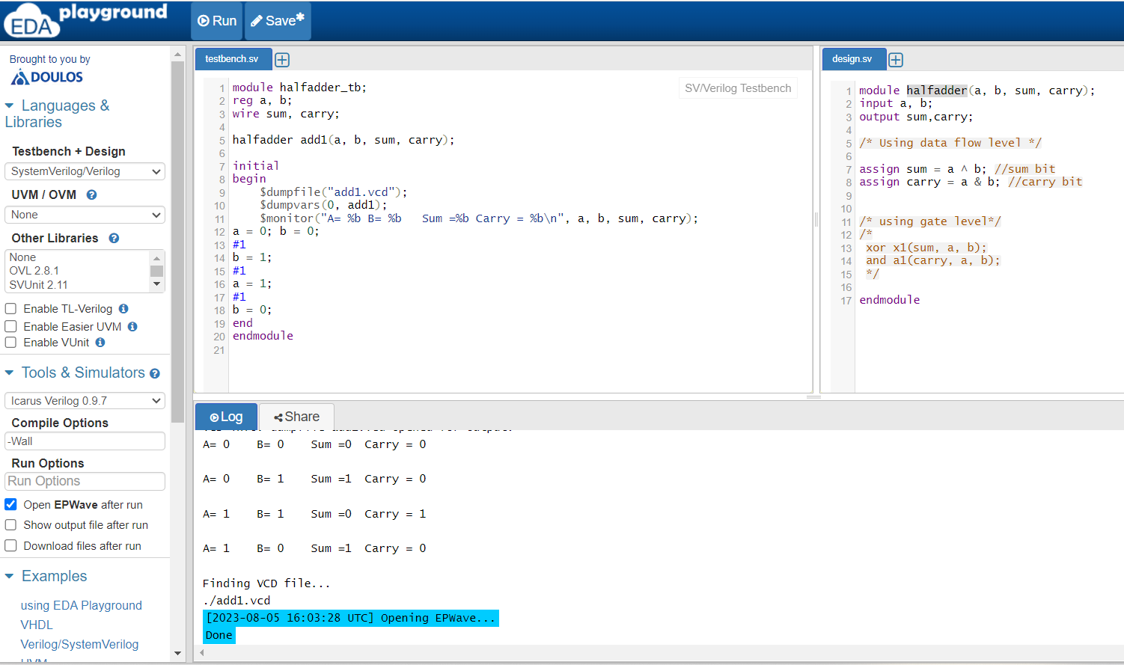
https://www.edaplayground.com/home

Slide 9
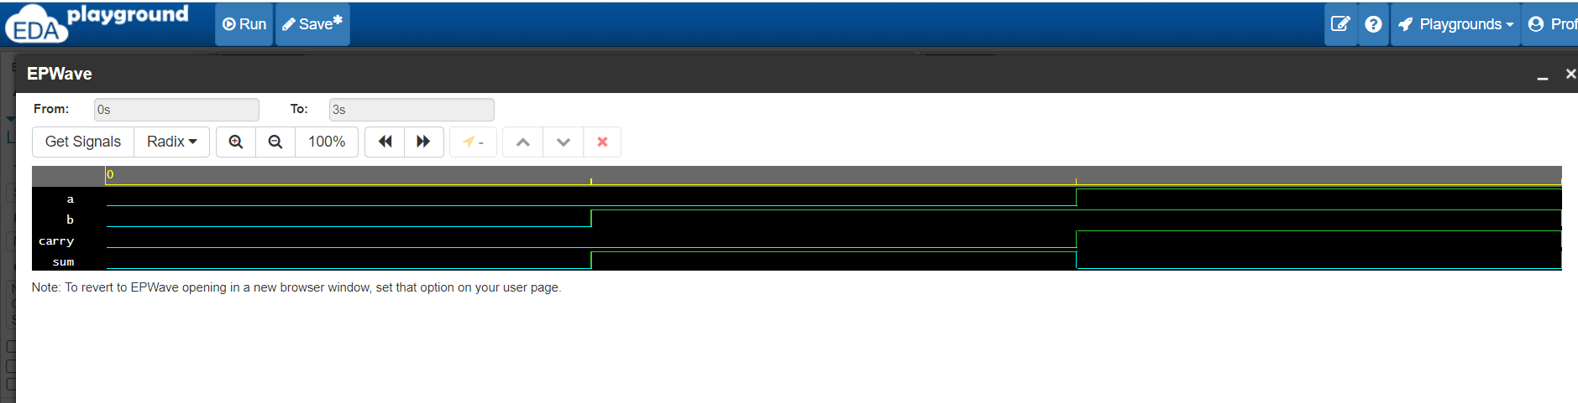
https://www.edaplayground.com/home

Slide 10
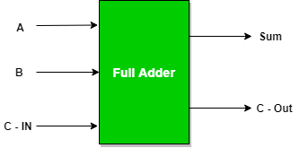
Experiment 3- Full Adder
To design and verify a full adder using S = x’y’z+x’yz’+xy’z’+xyz C=xy+xz+yz
Half Adder: it is the adder that adds three inputs and produces two outputs.
The first two inputs are A and B and the third input is an input carry as C-IN.
The output carry is designated as C-OUT and the normal output is designated as S which is SUM.

Slide 11
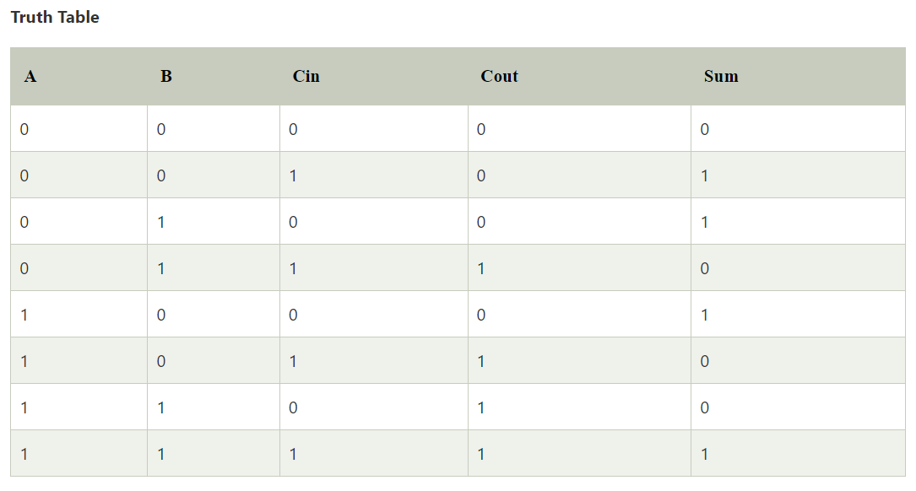
Experiment 3- Full Adder
To design and verify a full adder using S = x’y’z+x’yz’+xy’z’+xyz C=xy+xz+yz

Slide 12
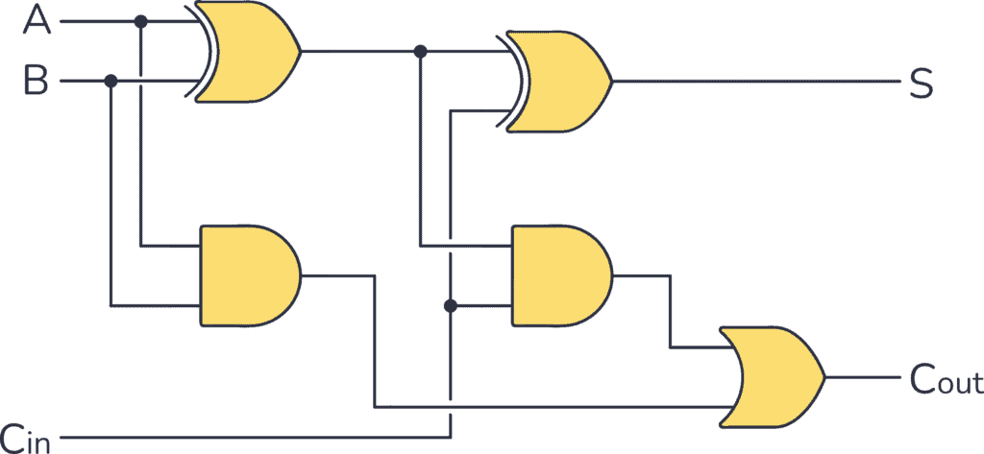
Experiment 3- Full Adder
To design and verify a full adder using S = x’y’z+x’yz’+xy’z’+xyz C=xy+xz+yz

Slide 13
Experiment 3- Full Adder
initial
begin
a= 0; b= 0; c= 0;
#5
a= 0; b= 0; c= 1;
#5
a= 0; b= 1; c= 0;
#5
a= 0; b= 1; c= 1;
#5
a= 1; b= 0; c= 0;
#5
a= 1; b= 0; c= 1;
#5
a= 1; b= 1; c= 0;
#5
a= 1; b= 1; c= 1;
end
endmodule
/*Full Adder Verilog Code*/
module fulladder(a, b, c, sum, carry);
input a, b, c;
output sum, carry;
wire sum, carry;
assign sum = a^b^c; //sum bit
assign carry = ((a&b) | (b&c) | (a&c)); //carry bit
endmodule
/* Test bench for Full Adder */
module main;
reg a, b, c;
wire sum, carry;
fulladder add(a, b, c, sum, carry);
always @(sum or carry)
begin
$dumpfile("add.vcd");
$dumpvars(0, add);
$display("Input A= %b B= %b C= %b Sum = %b Carry = %b\n", a, b, c, sum, carry);
end

Slide 14
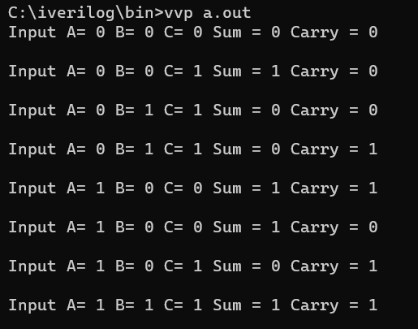

Slide 15
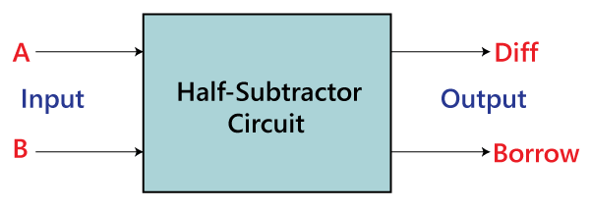
Experiment 3- Half Sub
To design and verify a half subtractor using D = x’y +xy’ B=x’y
Half Subtractor:
The half subtractor is also a building block for subtracting two binary numbers.
It has two inputs and two outputs.
This circuit is used to subtract two single bit binary numbers A and B.
The 'diff' and 'borrow' are two output states of the half subtractor.

Slide 16
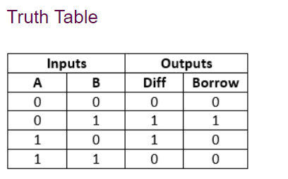
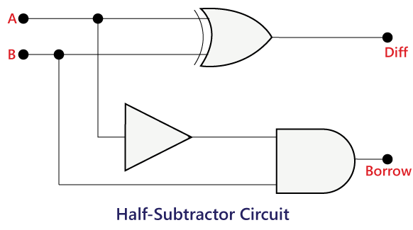
Experiment 3- Half Sub
To design and verify a half subtractor using D = x’y +xy’ B=x’y

Slide 17
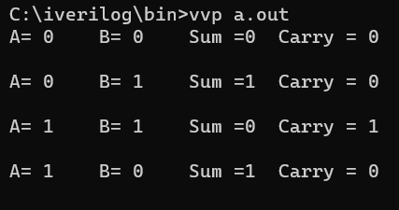
Experiment 3- Half Sub
To design and verify a half subtractor using D = x’y +xy’ B=x’y
module half_sub(input a, b, output D, B);
assign D = a ^ b;
assign B = ~a & b;
endmodule
a = 0; b = 0;
#1;
a = 0; b = 1;
#1;
a = 1; b = 0;
#1;
a = 1; b = 1;
end
endmodule
module half_sub_tb;
reg a, b;
wire D, B;
half_sub hs(a, b, D, B);
initial begin
$monitor("a=%b b=%b, difference=%b, borrow=%b", a,b,D,B);

